Slide 1

Elder Care: Commentary on the Legal Perspective
Michael J. Lamb J.D.
Barrister, Solicitor & Notary Public

Slide 2


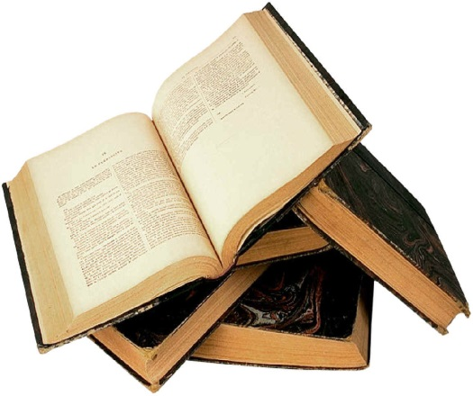
FORMS OF ABUSE
WHAT THE LAW SAYS
THE FUTURE

Slide 3

FINANCIAL ABUSE
The Little Black Book of Scams
Seniors Guidebook to Safety and Security

Slide 4

Magic Tricks
Bank Inspector
Home renovations
Door to door sales
Utility inspection
Charity donations
Lottery
Free vacation
Prize
Medical cures
Fake websites
Phishing
Online auctions
Malicious software

Slide 5

Estate manipulation
Joint ownership
Power of Attorney
“Loans”

Slide 6

HIGH
C
O
M
P
L
E
X
I
T
Y
LOW
65
90
AGE

Slide 7


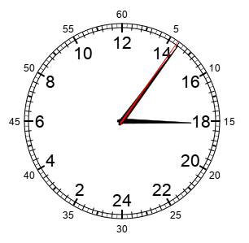
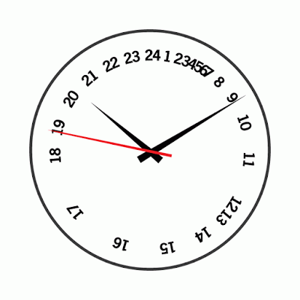
GAME TIME

Slide 8

Long – Term Care Homes Act, 2007
Retirement Homes Act, 2010
Substitute Decisions Act, 1992

Slide 9

Law Reform Commission of Ontario Project

Slide 10
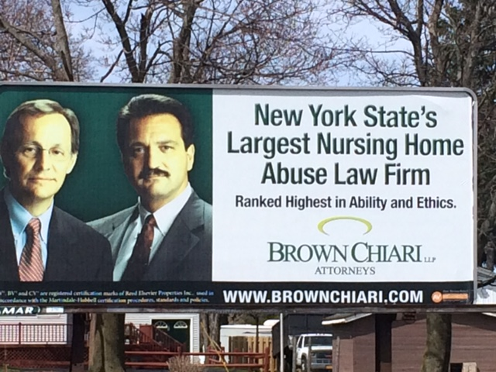

Slide 11

Thank You ☺
Conclusion

